Slide 1
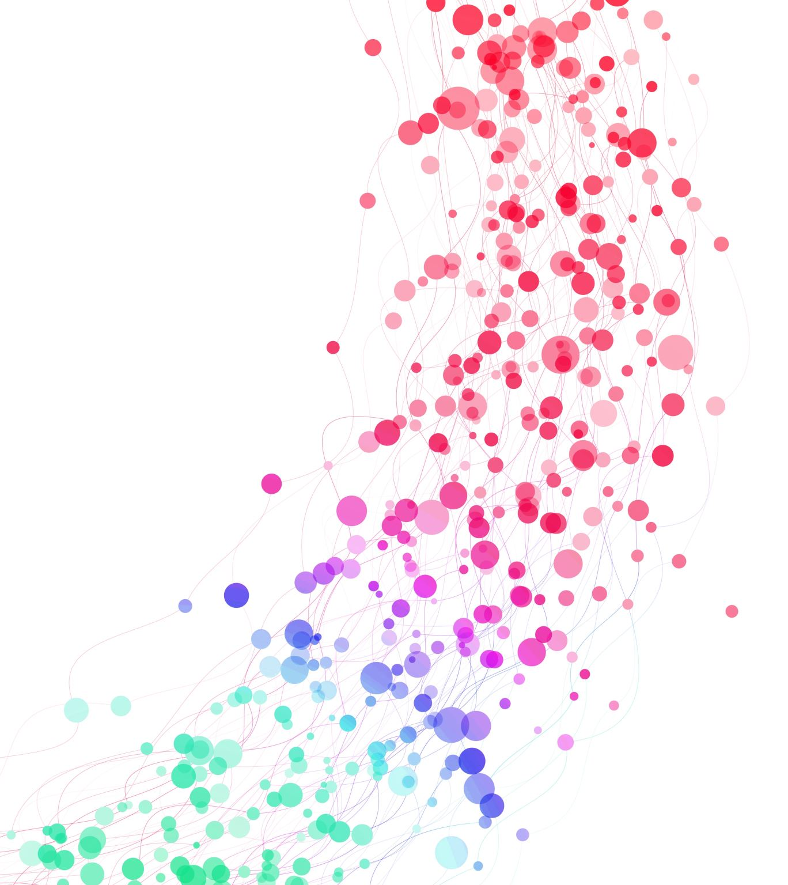

Slide 2

University of Pisa Computer Architecture 2023-24
KMeans parallel implementation
Students
Carlo Pio Pace
Davide Vigna

Slide 3
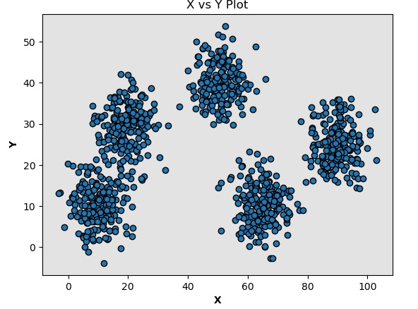
The Algorithm
1) Start Execution
Input:
Dataset of points
Number of clusters K
Max # of iterations
Output:
A set of K points called Centroids
The membership of each point in the dataset to one of the K clusters
Parameters:
K=5
Max # of iterations = 10

Slide 4
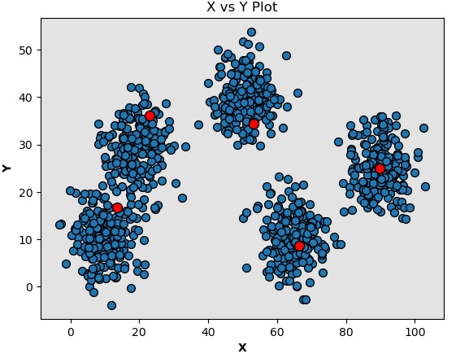
The Algorithm
2) Initialization of K random Centroids
Input:
Dataset of points
Number of clusters K
Max # of iterations
Output:
A set of K points called Centroids
The membership of each point in the dataset to one of the K clusters
Parameters:
K=5
Max # of iterations = 10

Slide 5
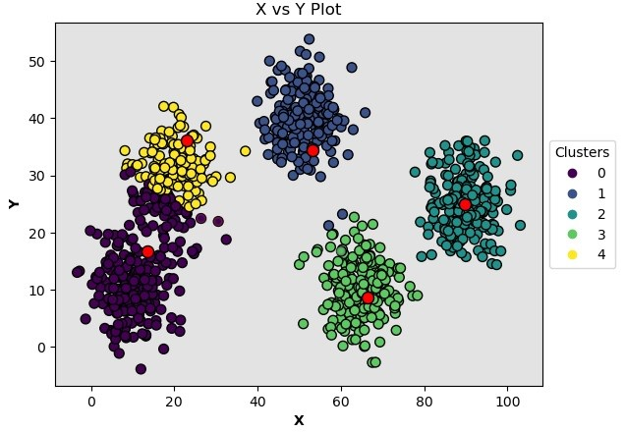
The Algorithm
3) Assign points to clusters
Input:
Dataset of points
Number of clusters K
Max # of iterations
Output:
A set of K points called Centroids
The membership of each point in the dataset to one of the K clusters
Parameters:
K=5
Max # of iterations = 10

Slide 6
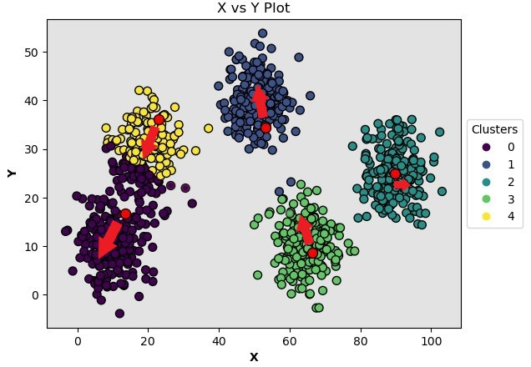
The Algorithm
4) Update Centroids
Input:
Dataset of points
Number of clusters K
Max # of iterations
Output:
A set of K points called Centroids
The membership of each point in the dataset to one of the K clusters
Parameters:
K=5
Max # of iterations = 10

Slide 7
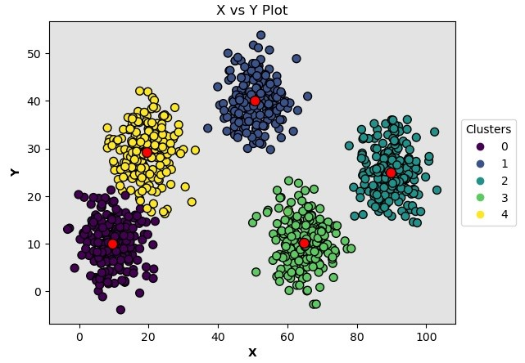
The Algorithm
5) Repeat from 3 until Max # of iterations
Input:
Dataset of points
Number of clusters K
Max # of iterations
Output:
A set of K points called Centroids
The membership of each point in the dataset to one of the K clusters
Parameters:
K=5
Max # of iterations = 10

Slide 8
The Goal
To obtain a solution that has an execution time of maximum 5 seconds on 10M dataset points.

Slide 9

How to make it work in parallel
Points
Thread 1
Assign points to clusters
Thread 2
Assign points to clusters
…
Thread N-1
Assign points to clusters
Thread N
Assign points to clusters
Update Centroids
NEW CLUSTERS

Slide 10

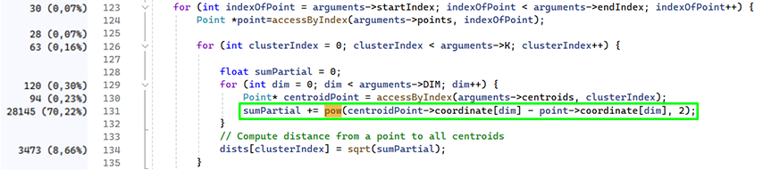
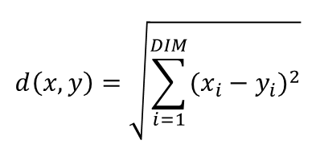

How to make it work in parallel
$$d\left(x,y\right)=\sqrt{\sum_{i=1}^{DIM}{{(x_{i}−y_{i})}^{2}}}$$
$$x∈R^{DIM},y∈R^{DIM}$$
Idea: exploit thread parallelism to work independently on different chunks of equal size of the dataset and then merge the results to update the centroids as in the sequential version.

Slide 11
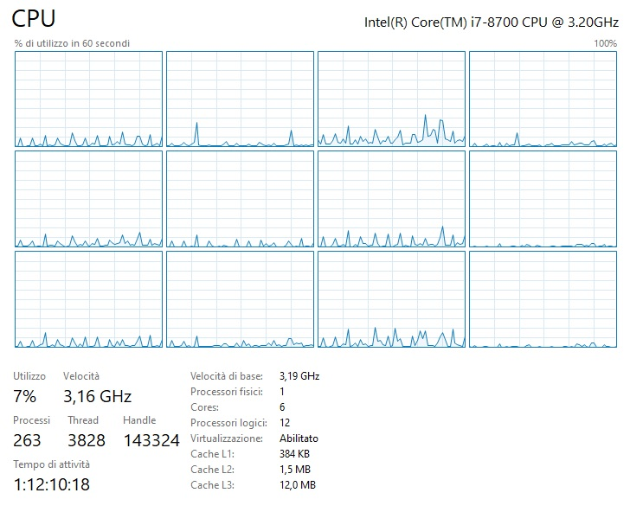
Architecture used
CPU: Intel® Core™ i7-8700 Processor
6 Cores, 12 Threads
Clock: Up to 3.20 Ghz
Max Turbo Frequency: 4.60 GHz
Cache:
Level 1: 384 KB
Level 2: 1.5 MB
Level 3: 12 MB
RAM: 16 GB DDR4 2133 MHz

Slide 12
Architecture used
Cache details
CPU: Intel® Core™ i7-8700 Processor
6 Cores, 12 Threads
Clock: Up to 3.20 Ghz
Max Turbo Frequency: 4.60 GHz
Cache:
Level 1: 384 KB
Level 2: 1.5 MB
Level 3: 12 MB
RAM: 16 GB DDR4 2133 MHz
Level 1 :
Data : 32 Kbytes 8-way set associative;
Instructions : 32 Kbytes 8-way set associative;
Level 2 : 256 Kbytes 4-way set associative;
Level 3: 12 Mbytes 16-way set associative;

Slide 13
Measuring method
Function clock() in time.h C library
Why:
It calculates CPU time and not Wall-clock time (with small errors)
On modern machines, precision of ms
C is a standard
C is the language in which we developed the algorithm
How it works:
The function clock() defined in this library returns the corresponding cpu time at the instant when it’s called.

Slide 14
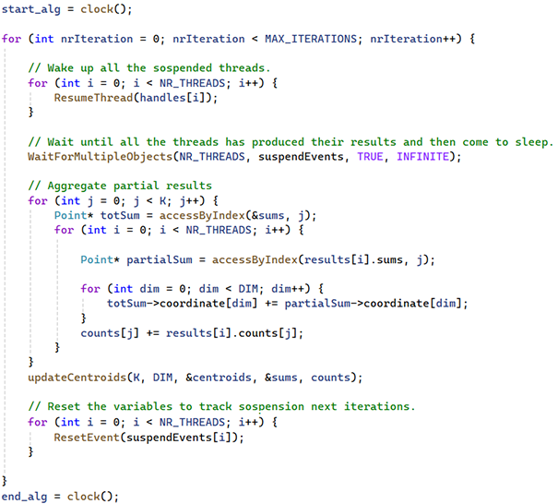
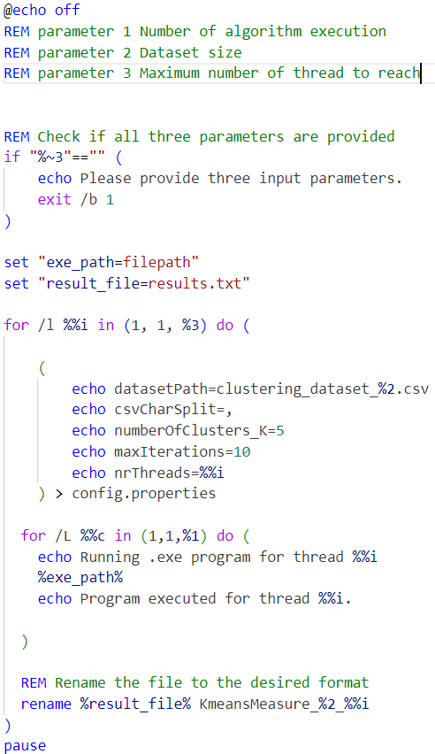
Measuring method

Slide 15
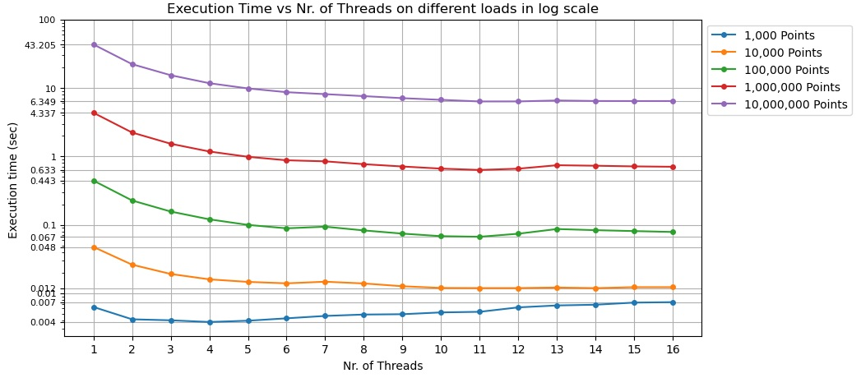
CPU time comparison

Slide 16
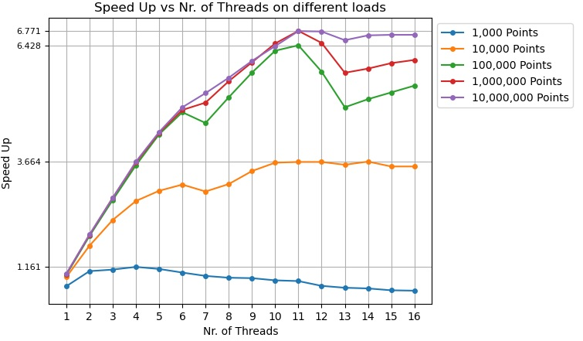
Speed Up

Slide 17

Speed Up – What’s Up?
CORE 0 | CPU 0 | CPU 1
CORE 1 | CPU 2 | CPU 3
CORE 2 | CPU 4 | CPU 5
CORE 3 | CPU 6 | CPU 7
CORE 4 | CPU 8 | CPU 9
CORE 5 | CPU 10 | CPU 11
How the software threads are assigned to our logical core units?
The O.S. schedule them according his own policy

Slide 18
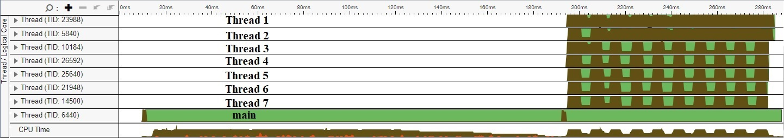
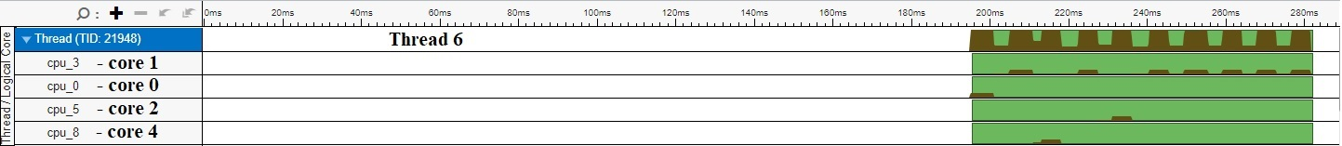
Speed Up – What’s Up?
- 100 000 Points dataset
- 7 Threads
- Clusters=5 & Max # of iterations = 10
Running
CPU in use

Slide 19
Speed Up – What’s Up?
Affinity:
The explicit request to O.S. to assign a process or thread to a specific logical core inside a specific physical core.

Slide 20

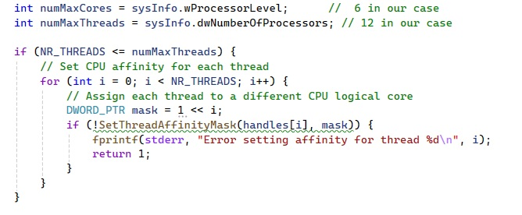
Using affinity
Following logical cores order
CORE 0 | CPU 0 | CPU 1
CORE 1 | CPU 2 | CPU 3
CORE 2 | CPU 4 | CPU 5
CORE 3 | CPU 6 | CPU 7
CORE 4 | CPU 8 | CPU 9
CORE 5 | CPU 10 | CPU 11
T1
T2
T3
T4
T5
T6
T7

Slide 21
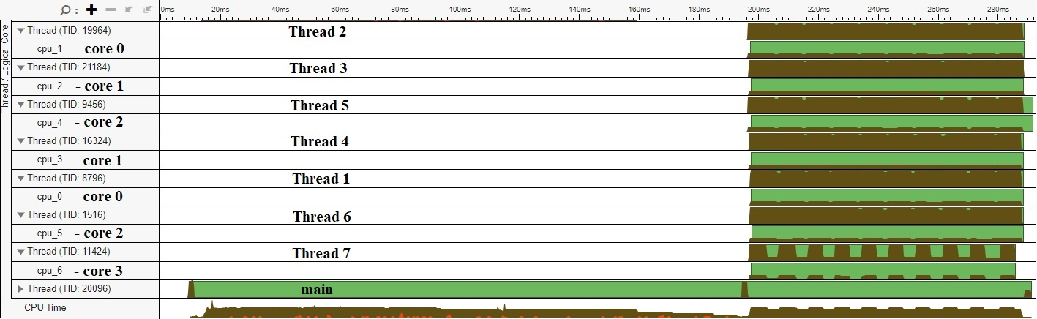
Following logical cores order
- 100 000 Points dataset
- 7 Threads
- Clusters=5 & Max # of iterations = 10
Running
CPU in use

Slide 22
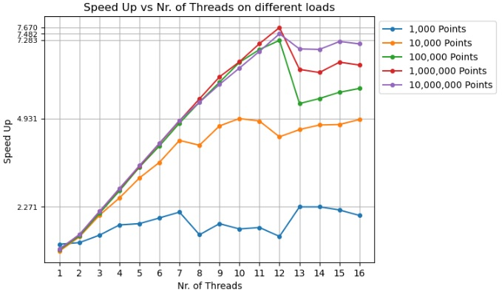
Speed Up
affinity set to follow logical cores order

Slide 23
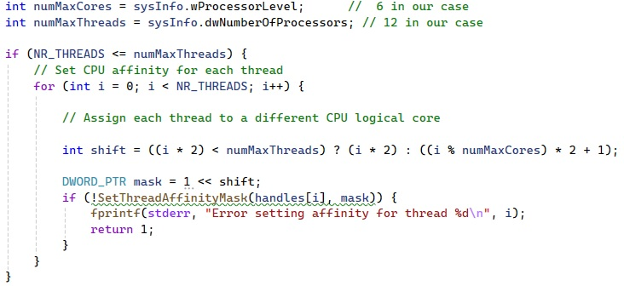
Using affinity
Following physical cores order
CORE 0 | CPU 0 | CPU 1
CORE 1 | CPU 2 | CPU 3
CORE 2 | CPU 4 | CPU 5
CORE 3 | CPU 6 | CPU 7
CORE 4 | CPU 8 | CPU 9
CORE 5 | CPU 10 | CPU 11
T1
T7
T2
T3
T4
T5
T6

Slide 24
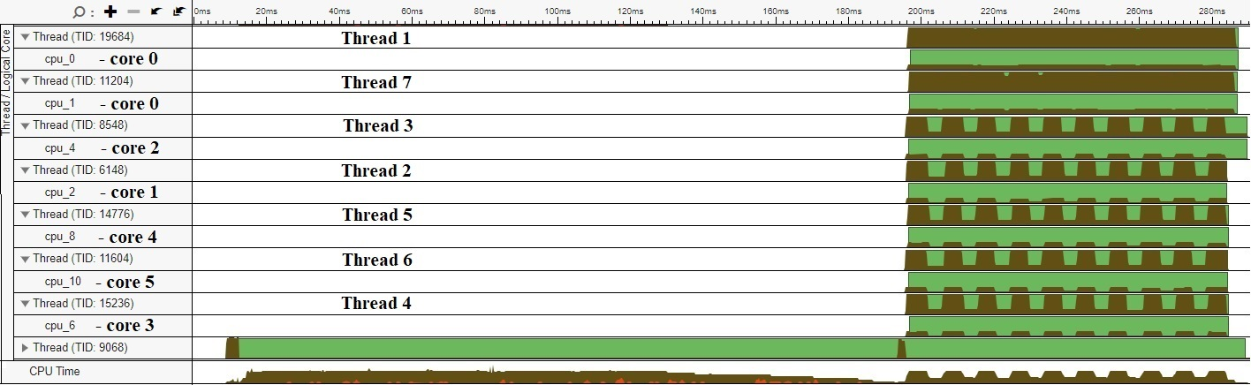
Following physical cores order
- 100 000 Points dataset
- 7 Threads
- Clusters=5 & Max # of iterations = 10
Running
CPU in use

Slide 25
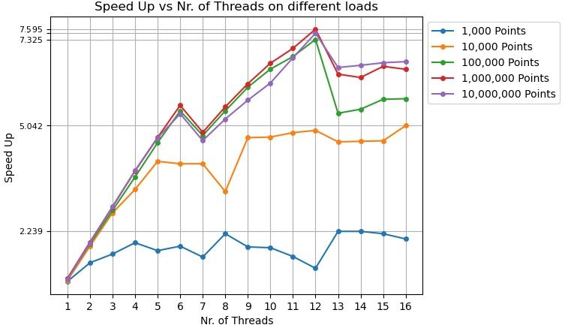
Speed Up
affinity set to follow physical cores order

Slide 26
What’s the cause of this effect?
Memory bound : issues on the memory subsystem (cache) that causes the introduction of stalls inside pipeline slots due miss.

Slide 27
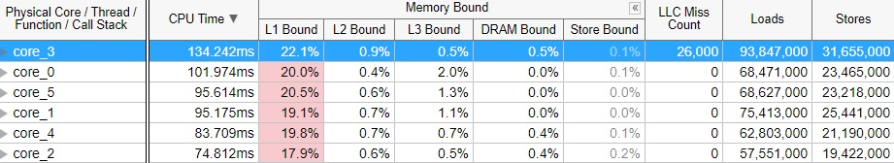
How to interpret the values
- 100 000 Points dataset
- 6 Threads
- Without Affinity

Slide 28
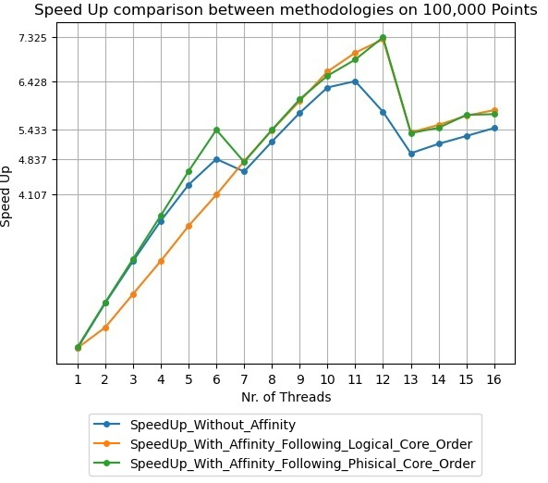
Speed Up
0,059 sec
0,074 sec
0,079 sec
0,088 sec
Comparison on 100.000 points with different affinity methodologies
0,105 sec

Slide 29
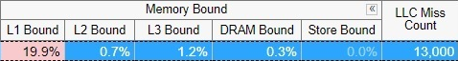
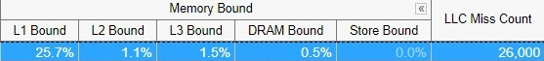
Speed Up
Comparison on 100.000 points with different affinity methodologies

Slide 30
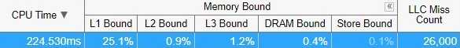
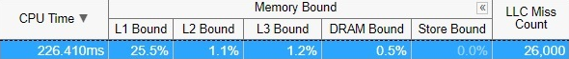
Speed Up
Comparison on 100.000 points with different affinity methodologies

Slide 31
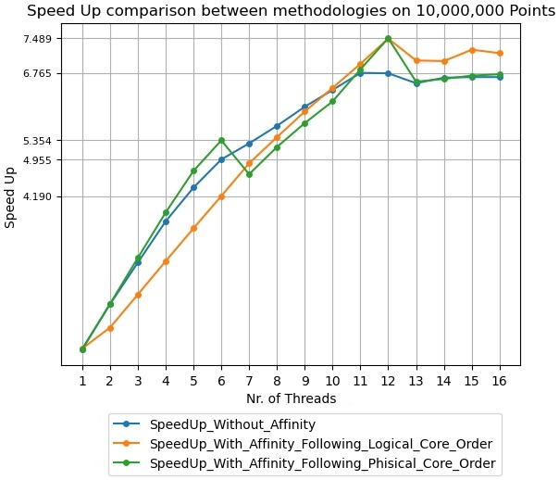
Speed Up
5,740 sec
8,022 sec
6,357 sec
8,668 sec
Comparison on 10.000.000 points with different affinity methodologies
10,251 sec

Slide 32
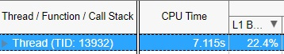
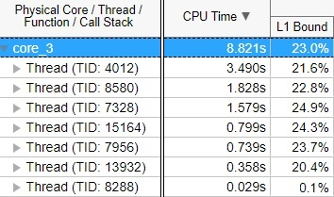
Speed Up
Comparison on 10.000.000 points with different affinity methodologies
The O.S obtains a smoother curve increasing the load and in some cases better than with fixed affinity management.

Slide 33
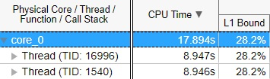
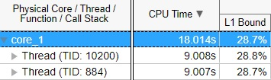
Speed Up
Comparison on 10.000.000 points with different affinity methodologies
The O.S obtains a smoother curve increasing the load and in some cases better than with fixed affinity management.

Slide 34
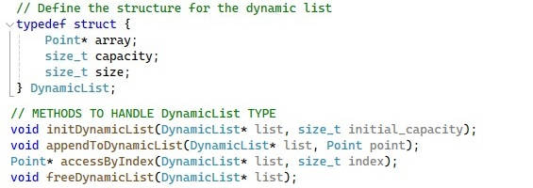
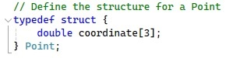
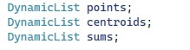
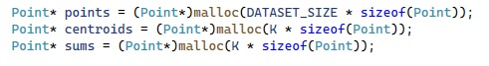
Optimizations
OPT.1: Data structures

Slide 35
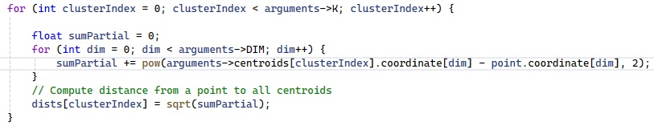
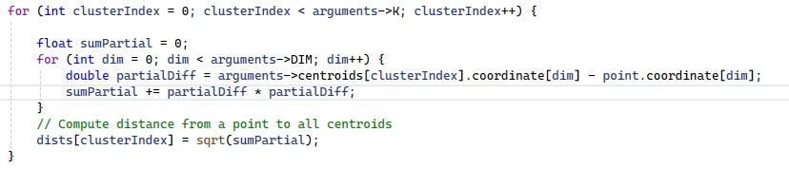
Optimizations
OPT.2: Math.h

Slide 36
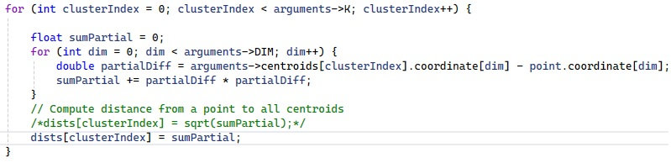
Optimizations
OPT.3: To act on the algorithm … a little
We are not actually interested in obtaining the exact distance, but only to discover the minimum among all the centroids.
We can avoid to compute the square root.

Slide 37
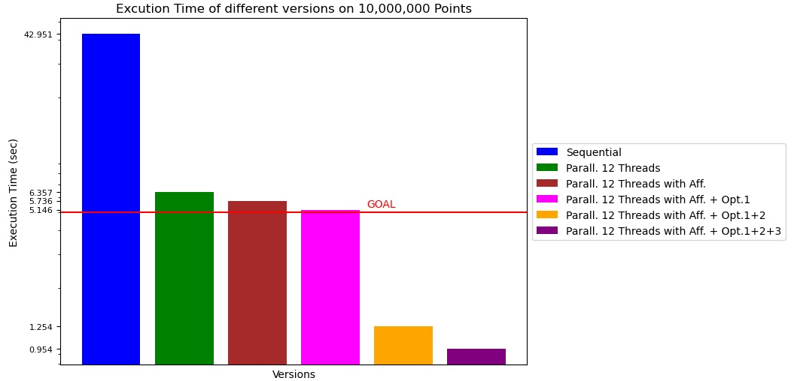
Optimizations results

Slide 38

If we use a GPU?

Slide 39
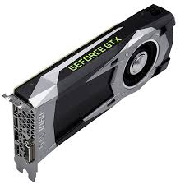
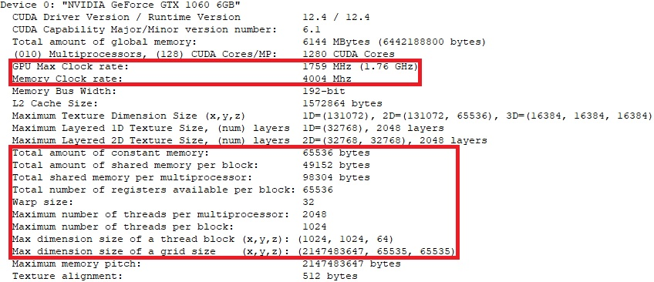
GPU Nvidia GeForce GTX 1060

Slide 40
GPU – Initial Version
We mantain the same exact structure of the parallel CPU version
2 kernel functions
1) assignPointsToClusterKernel<< <blocks, threads >> > (d_points, d_centroids, d_membership, d_sums, d_counts, SIZE);
2) updateCentroidsKernel << <1, K >> > (d_centroids, d_sums, d_counts);
Same measurement methods: function clock() in time.h C library
Focus on pure execution time
What is its behavior? How do we select the # of blocks and threads?

Slide 41
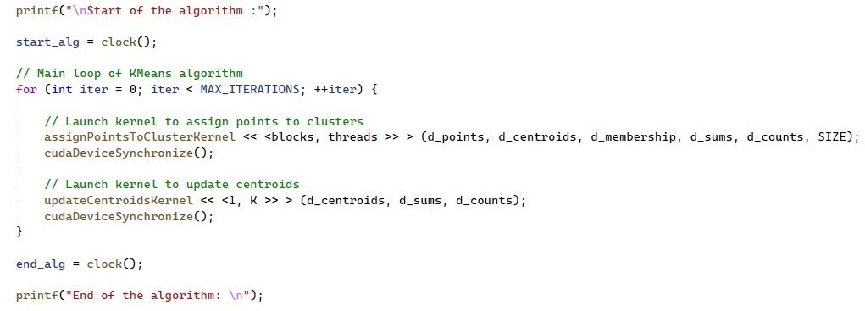
GPU – Initial Version

Slide 42
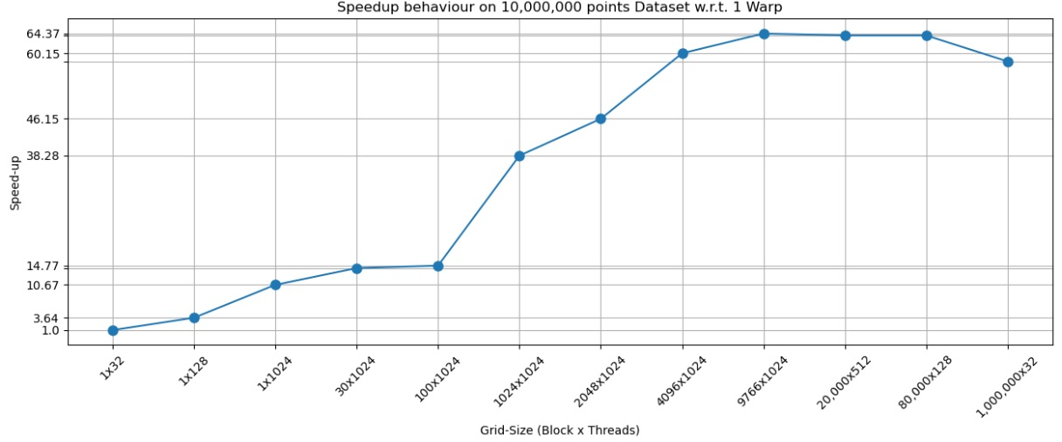
GPU – Initial Version
0,157 sec
1 point for each thread
10,106 sec
BLOCKS = (DATASET SIZE+NR_THREADS-1)/ NR_THREADS

Slide 43
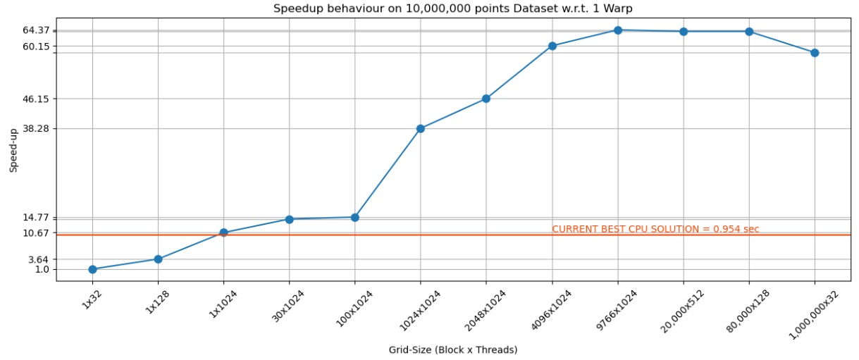
GPU – Initial Version
0,157 sec
Speedup x64 w.r.t. 1 warp
Speedup x6 w.r.t. CPU version
10,106 sec

Slide 44

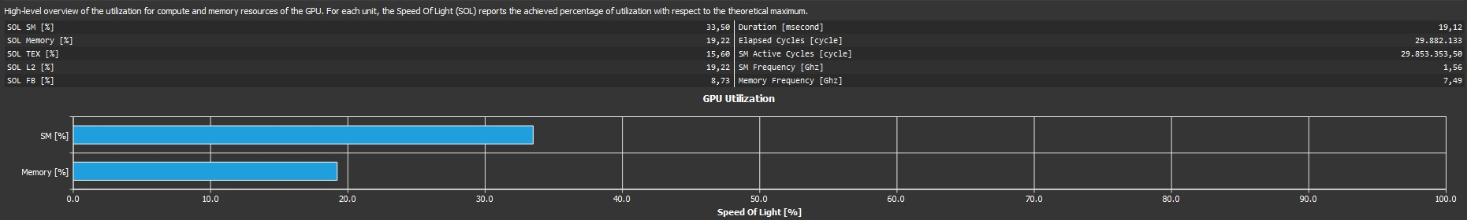
GPU – Profiler
v.2019

Slide 45
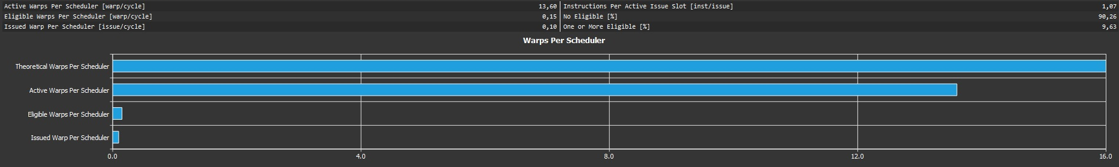
GPU – Profiler
v.2019

Slide 46
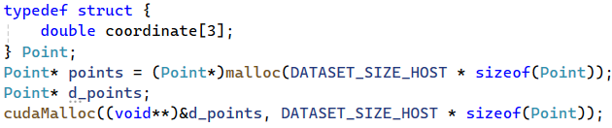
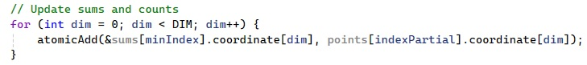
GPU – Considerations
Data structure used:
Operation performed:
Atomic operations on double generate errors at compilation time!!
We used this one!
Two options:
Harware option: nvcc kernel.cu -o KMeansCuda -arch=sm_61 (Faster)
Software (Slower)
How to solve?
https://docs.nvidia.com/cuda/cuda-compiler-driver-nvcc/index.html#gpu-feature-list

Slide 47
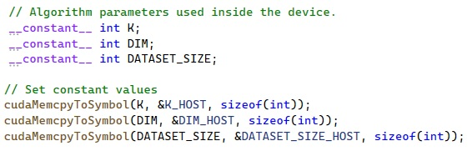

GPU – Considerations
Memory usage
Constant memory
Shared Memory

Slide 48

GPU – Considerations
To maximaze the usage of the architecure, considering that we are operating with bi-dimensional points, let’s exploit gpu features, and use a 2D grid, in order to do so, we need to change the data structure previuosly used, to a 2D matrix.
2D Matrix
of doubles

Slide 49


GPU – Considerations
2D-GRID

Slide 50

GPU – Considerations
We used block size large enough to cover the entire dataset, and in order to provide enough warps to schedule, using the architecture at it’s maximum.

Slide 51

Execution time comparison between Initial version and using a 2D Grid

Slide 52

GPU – Profiler
v.2019
We reached the goal of increasing the usage of the Multiprocessors (+60% SM utilization) but the exploiting of the memory subsystem of the cache is worse with the new version (-53%)
Initial Version
2D GRID

Slide 53
Why?

Slide 54
Flattening !
On gpu, if we are operating on bi-dimensional data, if is possible, is highly reccomended to perform a flattening and operate on one dimension data structure.
Our first implementation alredy used a data structure that exploited a sort of flattening.

Slide 55


Flattening !
To prove this supposition we used another data structure, a 2D matrix flattened to an array.
OFFSET=DATASET_SIZE

Slide 56

Comparison of execution time on 10 millions points between initial version, 2D Grid and Flattened version

Slide 57

GPU – Optimization
Reducing the number of calls on atomic operations: is there any way?
assignPointsToClusterKernel
How many times?
DATASET_SIZE x (DIM +1)
In our case: DIM=2 and DATASET_SIZE = 10 000 000
30 000 000 calls per iteration
Can we do better exploiting our GPU architecture?

Slide 58
GPU – Optimization
Rewrite assignPointsToClusterKernel in order to perform for each cluster a PARALLEL - TREE – REDUCTION exploiting the shared memory in each block
x-coordinates
y-coordinates
counts
0
1
2
3
4
5
6
7
8
9
10
11
Status of shared memory inside a block for i-cluster
5
0
3
2
2
0
4
8
1
0
1
1
stride = blockDim.x/2
T1
T2
8
0
0
2
6
0
0
8
2
0
0
1
T3
T4
Generic block
8
2
0
0
6
8
0
0
2
1
0
0
stride = stride /2

Slide 59
GPU – Optimization
Rewrite assignPointsToClusterKernel in order to perform for each cluster a PARALLEL - TREE – REDUCTION exploiting the shared memory of each block
x-coordinates
y-coordinates
counts
0
1
2
3
4
5
6
7
8
9
10
11
Status of shared memory inside a block for i-cluster
8
2
0
0
6
8
0
0
2
1
0
0
A BLOCK NEVER
HANDLES ONLY
4 THREADS!!
T1
T2
10
0
0
0
14
0
0
0
3
0
0
0
T3
T4
Now only T1 performs atomic opertations !!
Generic block
This is just an example: let see the impact on real data

Slide 60
GPU – Optimization
Reducing the number of calls on atomic operations
Initial version: DATASET_SIZE x (DIM +1) → 30 000 000 calls per iteration
Opt. version: NR_BLOCKS x (DIM +1 ) x K → ~ 150 000 calls per iteration
DIM=2
DATASET_SIZE = 10 000 000
NR_BLOCKS=9766
THREADS=1024
K(# of clusters)=5
PAY ATTENTION: the opt. version introduces additional synchronizations among threads in the same block
__syncthreads();
We have to find a trade-off between # of blocks and # of threads

Slide 61

GPU – Optimization
-12%
Special case
# Atomic Op.
30 M
150 K
300 K
600 K
1.2 M
300 K

Slide 62

GPU – Optimization
v.2019
Without parallel tree
With parallel tree

Slide 63

GPU – Optimization
v.2019
Without parallel tree
With parallel tree

Slide 64

GPU – Optimization
v.2019
__syncthreads();
Without parallel tree
With parallel tree

Slide 65
Optimizations summary
For CPU Parallel version:
From a dynamic list of points, to an array of points [Opt.1];
Switching from usage of pow() function, to executing directly the square of the number (N²=N X N) [Opt.2];
Find the minimum distance between to points, without using the square root [Opt.3];
For GPU version:
Usage of parallel tree reduction technique;

Slide 66

Conclusions
Speedup x309 w.r.t. first version
Speedup x7 w.r.t. best CPU version
TARGET ACHIEVED

Slide 67
Thank you

